Slide 1

Presented by Omolara Buhari Data analytics EU –class B-Cohort 25-04 Project Name: NovaMed Solutions: Sales Performance Analysis and Reporting

Slide 2
OUTLINE
Introduction
Aim of the Project
Business Problem
Approach - Analysis of NovaMed's performance
Dashboard: Top / Bottom Analysis(1) and Customer Analysis(2)
Key Insights
Recommendations
Conclusion

Slide 3
Introduction
NovaMed Solutions is a leading pharmaceutical distributor supplying essential medications to a diverse healthcare sector. Currently, NovaMed is facing challenges in optimizing sales performance, efficiently managing inventory, and identifying key market opportunities.
The company has collected detailed sales data, covering revenue, profit margins, drug sales performance, and customer demographics. This dataset provides a valuable opportunity for in-depth analysis, trend identification, and data-driven decision-making to enhance business strategies and streamline operations.

Slide 4
Aim Of The Project
Project Objective: Provide support to the NovaMed company in making smart, data-driven decisions through effective data analysis and visualization to enhance sales monitoring and customer insights.
Key Objectives:
Data Cleaning: Prepare clean datasets, accurate datasets for reliable analysis.
Data Analysis: Use Power BI Tools such as Power BI desktop, Visualization pane, Power Query editor, DAX, and Data modeling to uncover trends and patterns.
Dashboarding: Design a clear visual dashboard using Filters, a visualization graph, and slicers to present insights.
Business Insights: Deliver actionable recommendations based on data findings to guide strategic decisions.

Slide 5
Business Problem
Inaccurate demand forecasting and inefficient inventory management processes
Challenges in pinpointing best-selling and underperforming products and customer segments
Insufficient understanding of customer purchasing patterns and demographic profiles.
Absence of visual, data-driven strategies to enhance operational efficiency and seize market opportunities

Slide 6
Data Analysis Approach
Data was imported into Power BI, transformed, and loaded into Power BI Desktop to visualize the interplay of activities in various customer segments, countries, and products(Drugs)
Top / Bottom Performance Analysis was conducted using interactive dashboards. The key sales metrics—revenue, profit, and cost of goods sold (COGS)—with month-over-month comparisons were calculated on the data sets and included on the dashboard. Top-performing and underperforming drugs and customers based on dynamic, filterable measures to support data-driven decisions were included on the dashboard
Customer Analysis was used to explore customer demographics, revenue distribution by buyer type, and purchasing patterns. Geographic sales maps were included to visualize regional performance, helping identify key revenue sources and potential market opportunities.

Slide 7
Visual Analysis of NovaMed’s Data (including Dashboards)
Top / Bottom Analysis
2. Customer Analysis

Slide 8
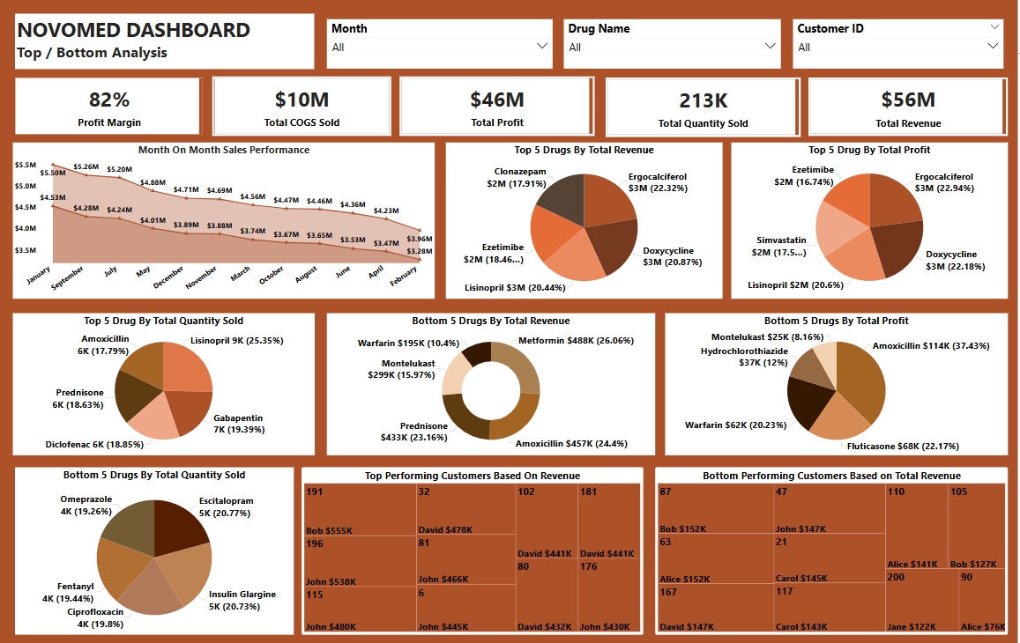

Slide 9
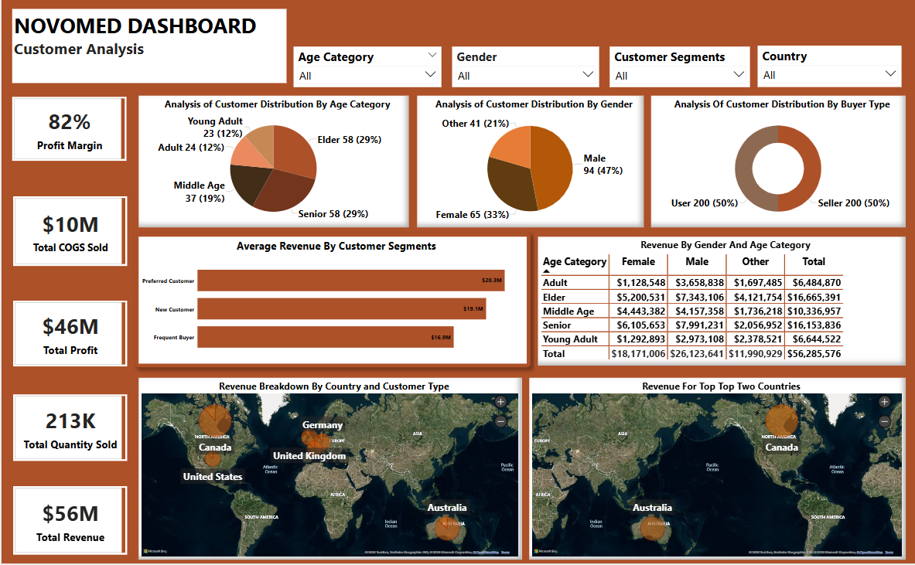

Slide 10
Key Insights
Top/Bottom Analysis
Top KPIs (Key Performance Indicators):
Profit Margin (82%) – A High margin indicates strong profitability
Total Cost of Goods Sold ($10M) – How much it costs to produce or buy the drugs
.
Total Profit ($46M) – Revenue minus cost
Total Quantity Sold (213K) – Total units of all drugs sold
Total Revenue ($56M) – Total income from sales

Slide 11
Visual Analysis of NovaMed’s Data (including Dashboards)
Top / Bottom Analysis
2. Customer Analysis

Slide 12
Key Insights
Top/Bottom Analysis
Overall Sales Trends & Profitability
Month by Month Sales Performance:
Overall revenue & profit presented at their lowest in February ($3.3M )(winter months), with January($5.5M) showing the highest revenue and profit
Revenue by Country
Canada is bringing in the highest revenue, but in contrast, the United States is bringing in the lowest.

Slide 13
Key Insights Top / Bottom Analysis Contd.
Top Selling & Underperforming Drugs
The 5 Top Drugs by total profit , by total revenue, and quantity sold
By Total Revenue:
Top revenue generators like Ergocalciferol, Doxycycline, etc.
Shows both value and percentage contribution.
By Total Profit:
Drugs like Ergocalciferol, Doxycycline, and Simvastatin bring the highest profit, which may differ from top revenue (due to cost differences).
By Total Quantity Sold:
Lisinopril leads with 9K units sold (25.35% of total volume).
This shows what sells most, regardless of price.

Slide 14
The 5 Underperforming drugs by total Profit, by total Revenue, and total quantity sold
Drugs like Warfarin, Montelukast, Fentanyl , Prednisone , and Amoxicillin are consistently underperforming in total profit or revenue, and in Quantity sold Indicates low pricing, low demand, or high production cost.

Slide 15
Key Insights Top / Bottom Analysis Contd.
Top performing Customers:
Our top customer like Bob ($555K) and John ($480K) are top contributors.
Underperforming Customers
Customers such as Alice($141K,), Carol ($141K,) and Jane ($152K) showed low engagement.

Slide 16
Key Insights
Customer Analysis
1. High-Engagement Segments
Top Customer Segment: Preferred Customers yield the highest average revenue ($20.3M).
2. Low Engagement Segments:
In the customer type, frequent buyers had the least revenue of the top performers, indicating that they were likely buying cheaper-priced drugs.

Slide 17
.
Key Insights
Customer Analysis Contd…
3. Demography: Age & Gender Trends
Purchases were concentrated among certain age brackets, with notable gender-based preferences in drug types. Elderly and senior customers are high-value groups in terms of both number and revenue.
Male customers contribute nearly half of the total revenue.
4. Demography: Buyer Types
Equal split between Users and Sellers (50% each). Pharmacies emerged as the most profitable buyer type, followed by hospitals

Slide 18
Key Insights
Customer Analysis Contd…
Countries: Top Markets
Two countries, Canada and Australia, are identified as the two top-performing countries contributing the largest to sales. Other mapped insights revealed untapped regions.
Countries: Regional Gaps
The United States, including North America, and European countries such as France and the United Kingdom, performed the lowest by revenue contribution across the different customer segments and their purchasing behaviour. These low-performing regions are flagged for further exploration and/or targeted campaigns.

Slide 19
Recommendation
Focused Production:
Novamed currently produces 39 drugs. Refine its current strategy to optimize the sales of higher-priced drugs with low COGS and high profits like Lisinopril, Doxyclycine,Ciprofloxacin, Monetasone to benefit more from manufacturing fewer of the cheaper drugs like Montelukask, Hydrochlorothia, Amoxicillin with low sales prices, high COGS and low profits even with high volume sales.
Targeted Marketing Campaigns/Incentives:
Design targeted marketing campaigns and/or incentives to retain new customers currently contributing about 24m in the six geographical regions with nearly half of that (11m) contributed from Canada.

Slide 20
Conclusion
The NOVOMED Sales dashboard reveals strong profitability and highlights clear product and customer segments for strategic focus. By leveraging this data, NOVOMED can enhance sales efficiency, reduce losses from underperforming products, and strengthen customer value.
The NOVOMED Customer Dashboard highlights a well-performing business with clear high-value customer groups. With Elder and Senior customers as top revenue drivers, and males forming nearly half of the customer base, NOVOMED can refine its marketing, sales, and engagement strategies to enhance profitability. Geographic and customer segment insights offer clear paths for strategic expansion and deeper market penetration.
By using these insights effectively, NOVOMED can sustain its impressive 82% profit margin and strengthen its market leadership in the pharmaceutical sector.

Slide 21
Thank you
Presented By Omolara Buhari
Data Analytics EU –Class B-Cohort 25-04
PowerBI Capstone Project:: NovaMed Solutions: Sales Performance Analysis and Reporting

